Slide 1


SAP S/4HANA Training
MASTER DATA GOVERNANCE (SAP MDG)
Neeraj Gupta
Session- 25
SAP MDG – Enterprise Services

Slide 2
25
SAP MDG – Enterprise Services
Services and Service Groups
Message inbound processing in the master data client and server systems
ProductMDMBulkReplicateRequest_In
[ProductMDMBulkReplicateConfirmation_In]
[MDM_PRD_REPLICATE_REQ]
MDM_PRD_REPLICATE_CONF
Point-to-point enterprise services communication
Role for SOA Manager Administration - SAP_BC_WEBSERVICE_ADMIN_TEC
Service User is created with role assignment
Business functions are active - FND_SOA_REUSE_1 (Improvements for SOA Reuse Functions)
Tools - SOA Mapping Tool, Error Handling, Point-to-Point Enablement for Asynchronous Enterprise Services
Activate support for Point2Point Communication
Connection to System Landscape Directory >> transaction SLDCHECK
Alternative - BAdI MDG_IDM_GET_LCL_SYSTEM
Configure Web Service Runtime
Activate the Error and Conflict Handler

Slide 3
25
SAP MDG – SOA for Data Replication
SOA Configuration for MDG (Transaction SOAMANAGER)
Create a profile for point-to-point communication
>> Profile names and versions should be identical in the SOA manager settings for both MDG hub and MDG client systems
>> No IBC (Identifiable Business Context) Determination, Secure Communication Only
Configure the client setting
>> Organization Name, Business System from SLD >> Business Application ID
Configure a provider system for the Business Scenario Configuration
>> SLD Identifier >> <client>.SystemName.<XYZ>.SystemNumber.<Installation
Number>.SystemHome.<Host> e.g. 416.SystemName.QV6.SystemNumber.0020270862.SystemHome.uxdbqv6
>> Access URL for WSIL >> format of WSDL - https://<hostname>:<port>/sap/bc/srt/wsil?sap-client=<client>
>> User for WSDL and a Password for WSDL >> service user that is created in the backend system
>> Business Application ID >> Application name and a description, for example: sap.com/BusinessApplicationABAP >> IBC reference for the counterpart system is generated automatically

Slide 4
25
SAP MDG – SOA for Data Replication
SOA Configuration for MDG (Transaction SOAMANAGER)
Edit Logon Data for Business Scenario
>> User account in the MDG hub and the MDG client system >> Logon Data Name and Description >> SERVICE_USER, Description is Generic Service User
Assign Logon Data to Provider IBC Reference
>> Provider IBC Reference >> Select the IBC reference of the counterpart system from the search result list

Slide 5
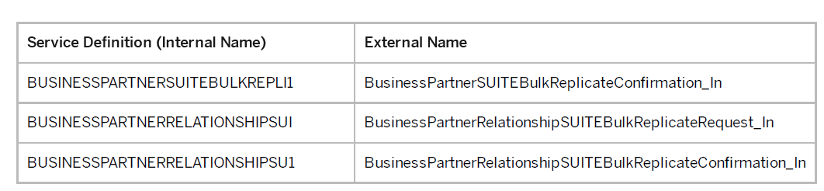
25
SAP MDG – SOA for Data Replication
SOA Configuration for MDG (Transaction SOAMANAGER)
Create Integration Scenario Configuration for Point-to-Point Communication using Service Group
>> Name and a description for the business scenario >> Search for service definitions and assign a profile
>> Assign profile to service definition >> profile MDG, choose Assign Profile
>> Select service groups and provider IBC reference
>> Assign business application >> Assign IBC Reference >> choose Assign to Service Group
>> Activate Business scenario after defining the business scenario in the MDG client system
>> Choose Process List to process all pending tasks
Set logical port as default

Slide 6
25
SAP MDG – SOA for Data Replication
Web Service Runtime Configuration
Use case
SOAP requests are processed using the Internet Communication Framework (ICF). The SAP NetWeaver AS uses the HTTP protocol of the ICF for communication between the Web service consumer and the Web service provider. The ICF provides the infrastructure for handling HTTP requests in work processes in an SAP system. An HTTP request calls a service in the ICF server. This service contains one or more HTTP request handlers that are responsible for running the ABAP functions
Creation of a service destination is required for each client including client 000 and in all other productive client systems

Slide 7
25
SAP MDG – SOA for Data Replication
Web Service Runtime Configuration
Technical Setup
Execute the Technical Setup in transaction SRT_ADMIN
ICF services required for standard functions of the Web service runtime:
/sap/bc/srt/
/sap/bc/srt/wsil
/sap/bc/srt/wsdl
/sap/bc/srt/esf_in
/sap/bc/srt/xip
/sap/bc/srt/rfc
/sap/bc/srt/pm
/sap/bc/srt/xip/sap
/sap/bc/srt/lsc
/sap/bc/srt/scs

Slide 8
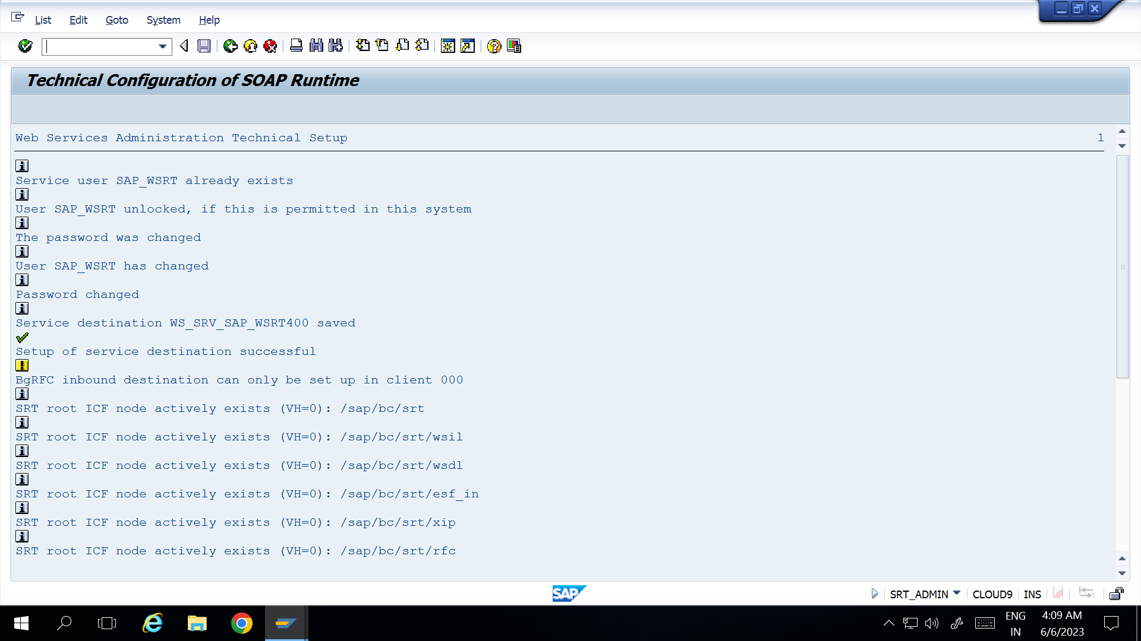
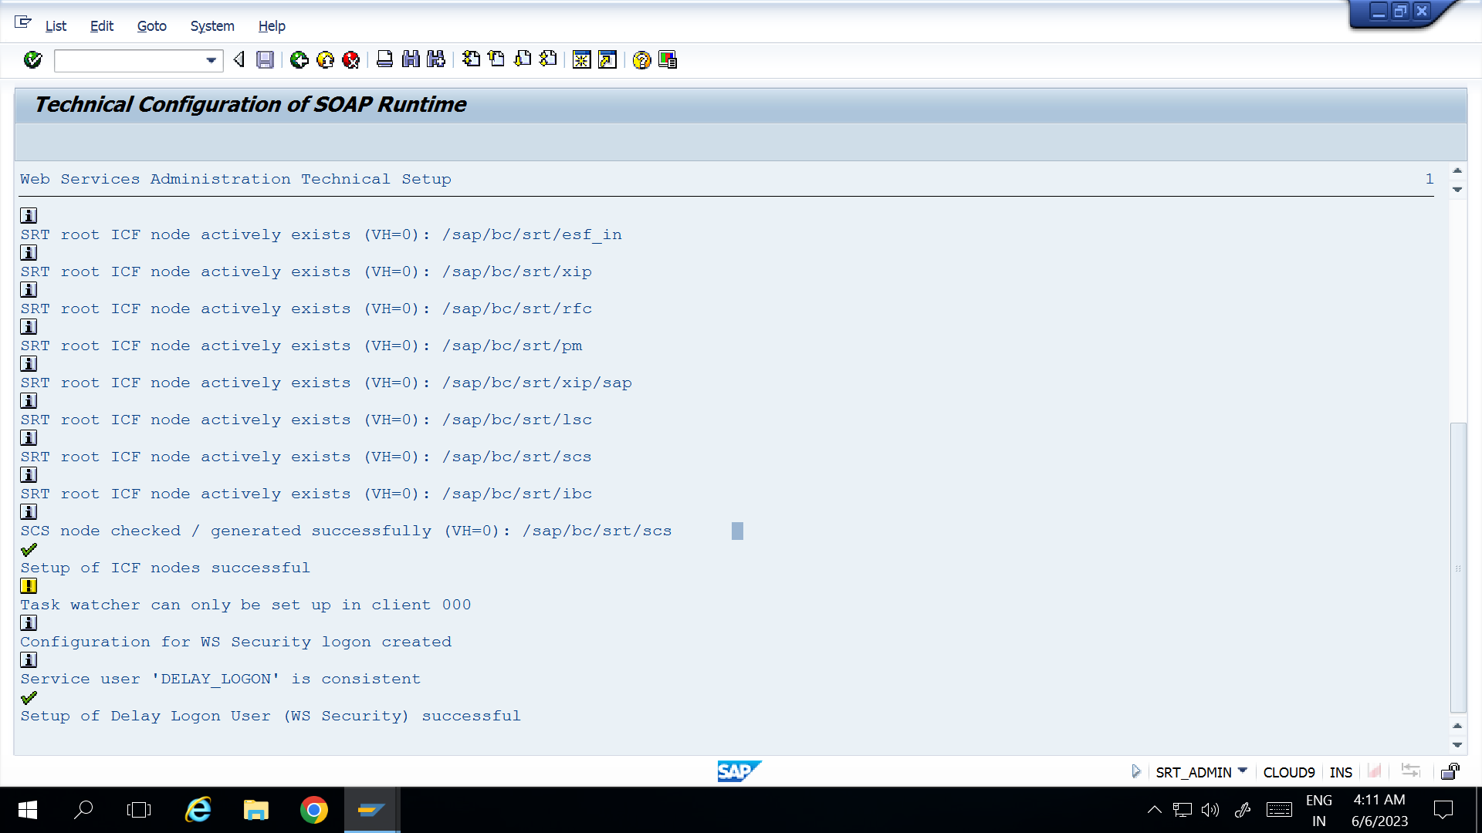
25
SAP MDG – SOA for Data Replication
Web Service Runtime Configuration (log and trace)
SOA Manager under Logs and Traces

Slide 9
25
SAP MDG – SOA for Data Replication
Web Service Runtime Configuration
Technical Setup
2. Schedule the background request SAP_SOAP_RUNTIME_MANAGEMENT
(Hourly as default setting)
3. Transaction SBGRFCCONF – Setup the bgRFC supervisor destination >> Define Supervisor Destination >> Assign user / password and role assignment >> SAP_BC_BGRFC_SUPERVISOR

Slide 10
25
SAP MDG – SOA for Data Replication
Web Service Runtime Configuration
Alternative - Technical Setup
Configuration in single steps – Create service destination
Service user with role SAP_BC_WEBSERVCE_SERVICE_USER
SM59 - Create a service destination for the service user
>> ABAP connection of type 3, name and the password for the service user, name of the current client
>> In Field gRFC Version = 0 (Classic qRFC)
>> Choose Remote Login to check the settings
c. Register the name of the destination using the SRT_ADMIN report
>> Field Name of ABAP Connection, checkbox Register ABAP Connection and execute the report

Slide 11
25
SAP MDG – SOA for Data Replication
Web Service Runtime Configuration
Alternative - Technical Setup
2. Perform the settings for the bgRFC
a. Transaction SBGRF CCONF >> Maintain Inbound Dest. Choose Create
(WS_INBOUND_DEST)
b. Sequences of the SOAP runtime are registered using queues. Queues are assigned a prefix so that they can be uniquely identified.
PERSC_
PERSP_
SRTQC_
SRTQP_
SRTQS_

Slide 12
25
SAP MDG – SOA for Data Replication
Web Service Runtime Configuration
Alternative - Technical Setup
3. Checking the Configuration
>> Report SRT_ADMIN_CHECK
Area: | Check:
System-Related Settings | Service Destination bgRFC Settings (inbound destination, supervisor destination) Job Runtime Management Task Watcher Data Collector for Payload Trace ICF node for SOAP runtime
Client-Specific Settings | Service Destinations for All Clients
Client-Specific Functions | Test Execution for Service Destination with Authorization Check

Slide 13
25
SAP MDG – SOA for Data Replication
Web Service Runtime Configuration
Message Persistency
Use:
All messages in the message monitor (transaction code SRT_MONI) and the column Persistency shows where a message is stored
Web service-specific persistency (WS persistency):
Start Web Service Utilities (transaction code SRT_UTIL)
2. Tools >> Global Configuration
Under Message Persistency, you see where your messages are stored.
If WS Persistency is displayed, all of your messages are stored in Web service persistency.
If PI Persistency is displayed, all of your messages are stored in PI Persistency.
If WS and PI Persistency is displayed, both persistencies are in use
3. Specify the retention period for messages in Web service Persistency. The default value is 40 days.

Slide 14

End of Session25

Slide 15

Questions

Slide 16

Neeraj gupta

Slide 17


We’re committed to empower you to be
Most Desirable Resource
through powerful training solutions.
We build the workforce of the future.
250+
Corporate Clients
30,000+
Learners Trained
25000+
Learners Placed
FREE WEBINARS
Sign up for free webinars with industry experts every fortnight!
Enroll Now!
Contact us today!
https://anubhavtrainings.com/

Slide 18




More from AnubhavTrainings.com

